Slide 1
Process Model

Slide 2
Introduction
we will discuss how the requirements definition and use cases may be further clarified through a process model
A process model is a graphical way of representing how a business system should operate
It illustrates the processes or activities that are performed and how data move among them
A process model can be used to document the current system (i.e., as-is system) or the new system being developed (i.e., to-be system), whether computerized or not.

Slide 3
DFD
Data flow diagramming is a technique that diagrams the business processes and the data that pass among them.
Although the name data flow diagram (DFD) implies a focus on data, this is not the case. The focus is mainly on the processes or activities that are performed
Process modeling—and creating DFDs in particular—is one of the most important skills needed by systems analysts.

Slide 4
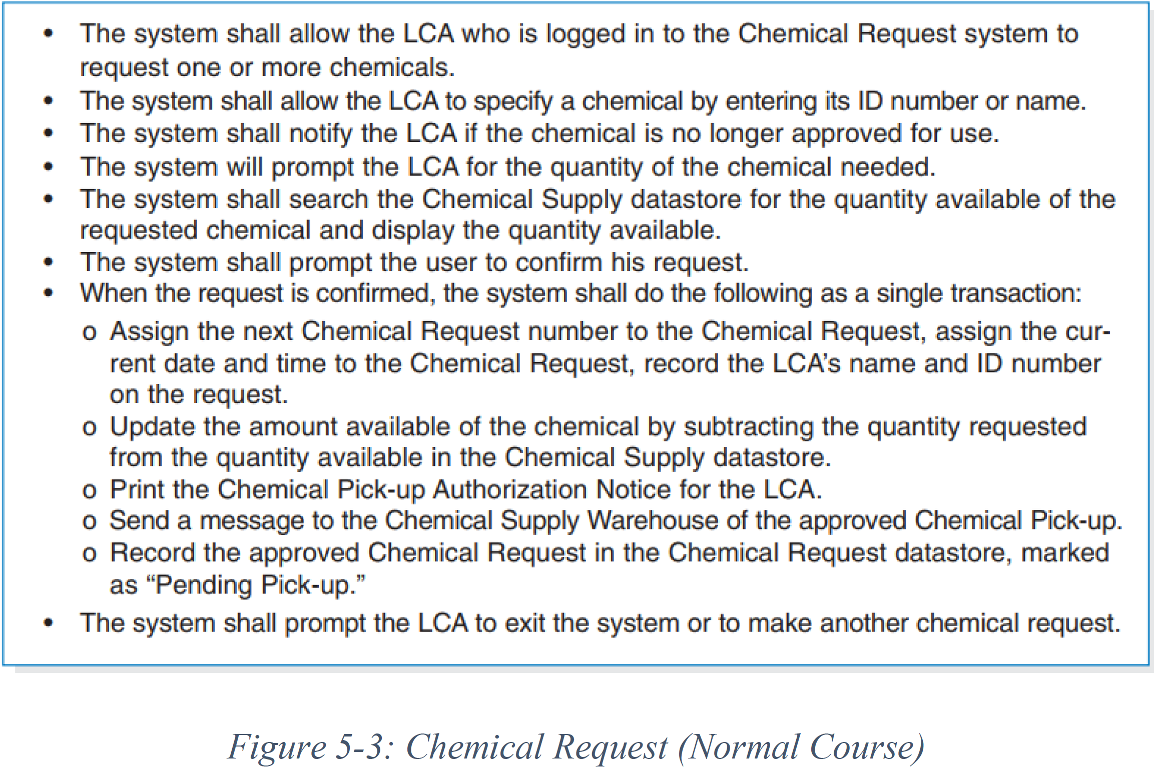
Remember

Slide 5
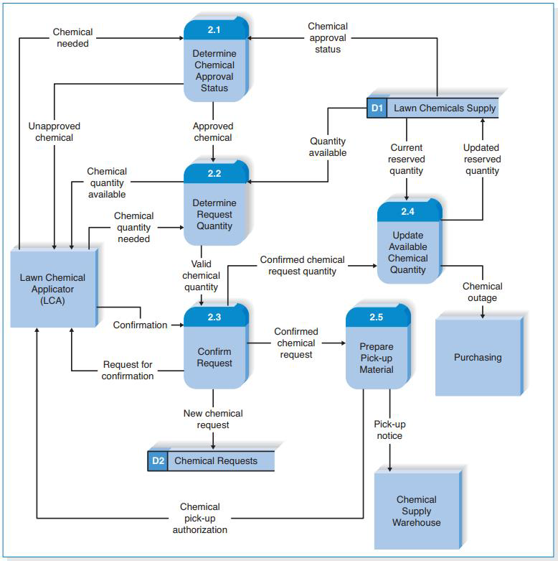
Reading Data Flow Diagrams

Slide 6
Elements of Data Flow Diagrams
DFDs include a set of
symbols,
naming conventions, and
syntax rules.

Slide 7
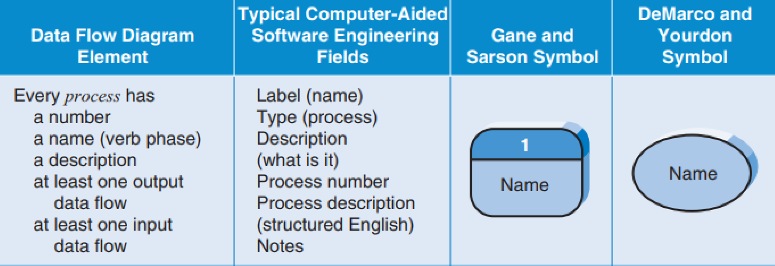
Symbols of Data Flow Diagrams
There are four symbols in the DFD language
1- processes

Slide 8
Process:
an activity or a function that is performed for some specific business reason
Every process should be named starting with a verb and ending with a noun
Names should be short, yet contain enough information so that the reader can easily understand exactly what they do
each process performs only one activity

Slide 9
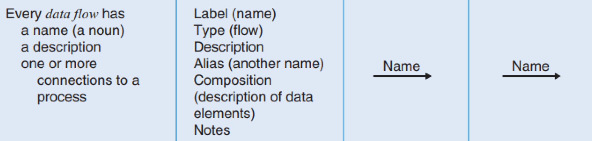
Symbols of Data Flow Diagrams
There are four symbols in the DFD language
2- data flows,

Slide 10
Data Flow
A data flow is a single piece of data or a logical collection of several pieces of information
Every data flow should be named with a noun
Data flows are the glue that holds the processes together. One end of every data flow will always come from or go to a process,
arrow showing the direction into or out of the process
show what inputs go into each process and what outputs each process produces
Every process must create at least one output data flow, because if there is no output, the process does not do anything. Likewise, each process has at least one input data flow, because it is difficult, if not impossible, to produce an output with no input

Slide 11
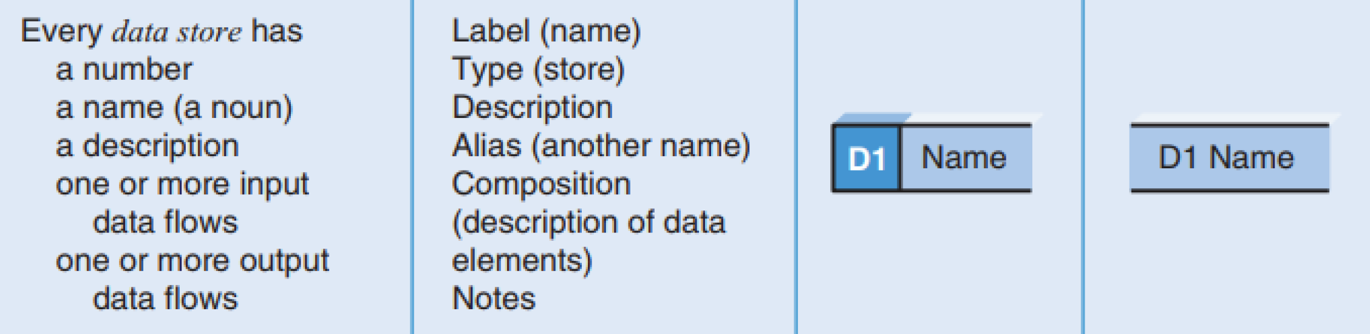
Symbols of Data Flow Diagrams
There are four symbols in the DFD language
3- data stores

Slide 12
Data Store
collection of data that is stored in some way
Every data store is named with a noun and is assigned an identification number and a description.
Data stores form the starting point for the data model and are the principal link between the process model and the data model
Data flows coming out of a data store indicate that information is retrieved from the data store.
Data flows going into a data store indicate that information is added to the data store
All data stores must have at least one input data flow.
Likewise, they have at least one output data

Slide 13
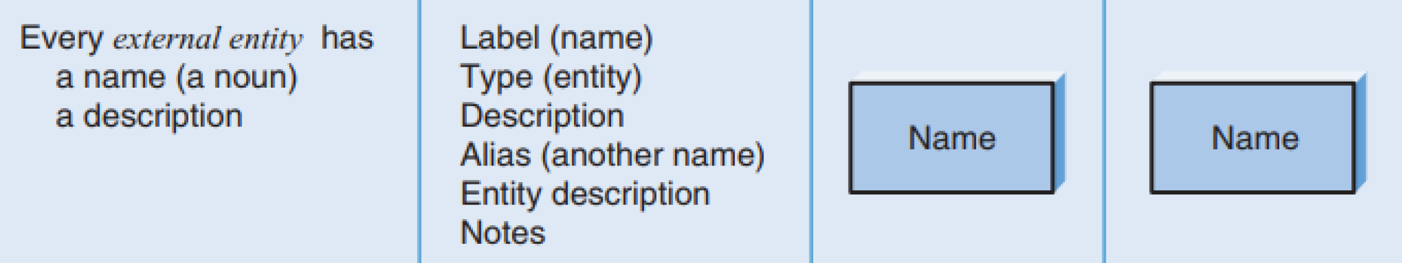
Symbols of Data Flow Diagrams
There are four symbols in the DFD language
4- external entities

Slide 14
External Entity
An external entity is a person, organization, organization unit, or system that is external to the system, but interacts with it
External entities provide data to the system or receive data from the system
Every external entity has a name and a description

Slide 15
Using Data Flow Diagrams to Define Business Processes
business processes are too complex to be explained in one DFD
process models are therefore composed of a set of DFDs
The first DFD provides a summary of the overall system
Additional DFDs providing more and more detail about each part of the overall business process
An important principle in process modeling with DFDs is the decomposition of the business process into a hierarchy of DFDs, with each level down the hierarchy representing less scope but more detail

Slide 16
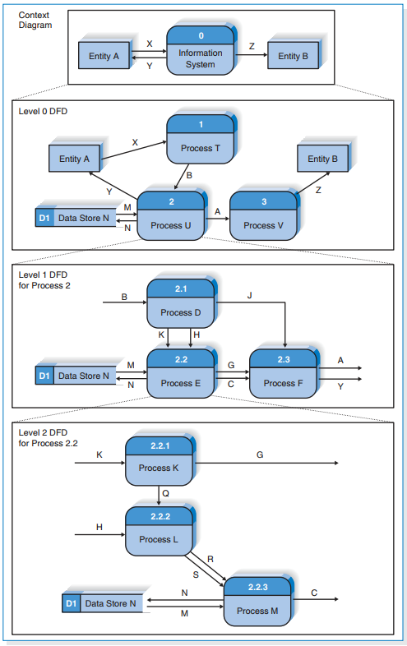
Relationships among Levels of Data Flow Diagrams

Slide 17
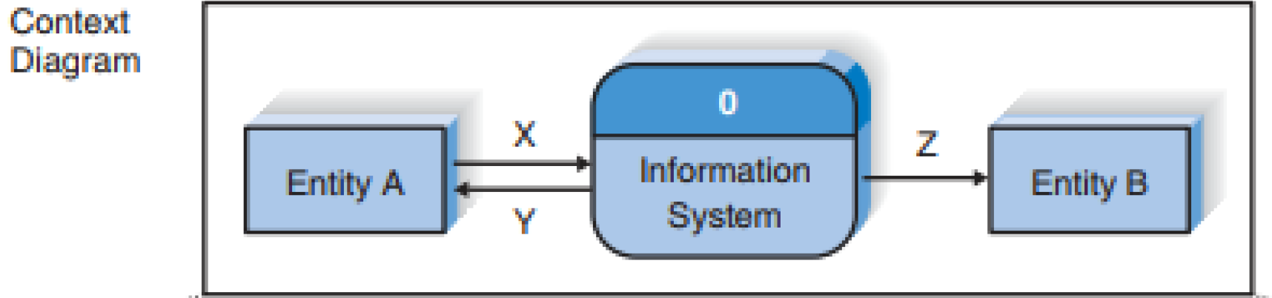
Context Diagram
shows the entire system in context with its environment
All process models have one context diagram
shows the overall business process as just one process and shows the data flows to and from external entities.

Slide 18
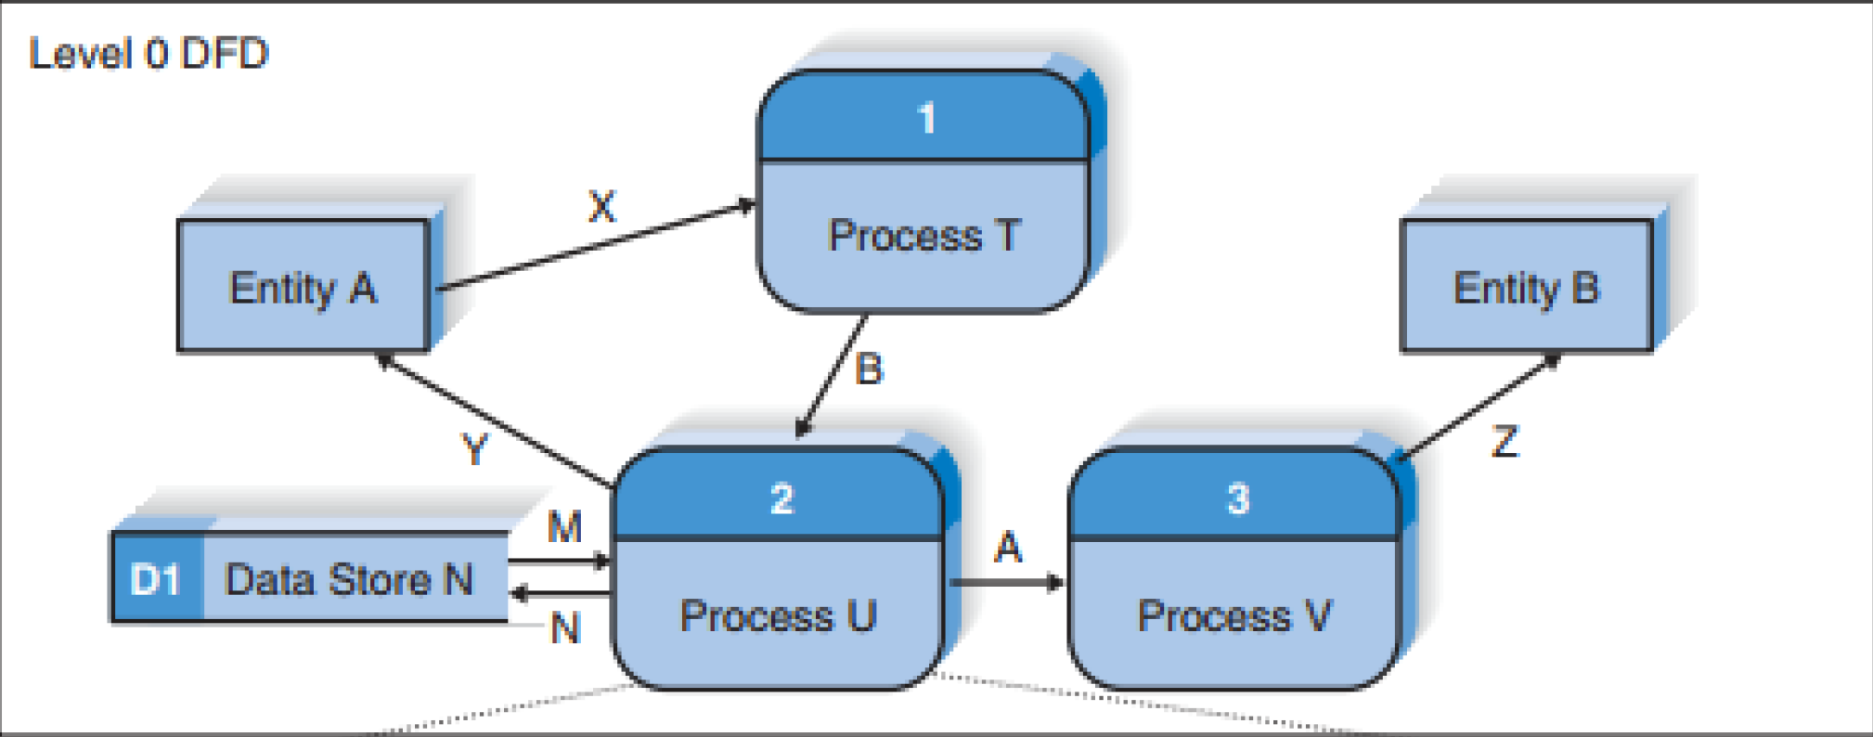
Level 0 Diagram
shows all the processes at the first level of numbering, the data stores, external entities, and data flows among them
show all the major high-level processes of the system and how they are interrelated.
All process models have one and only one level 0 DFD

Slide 19
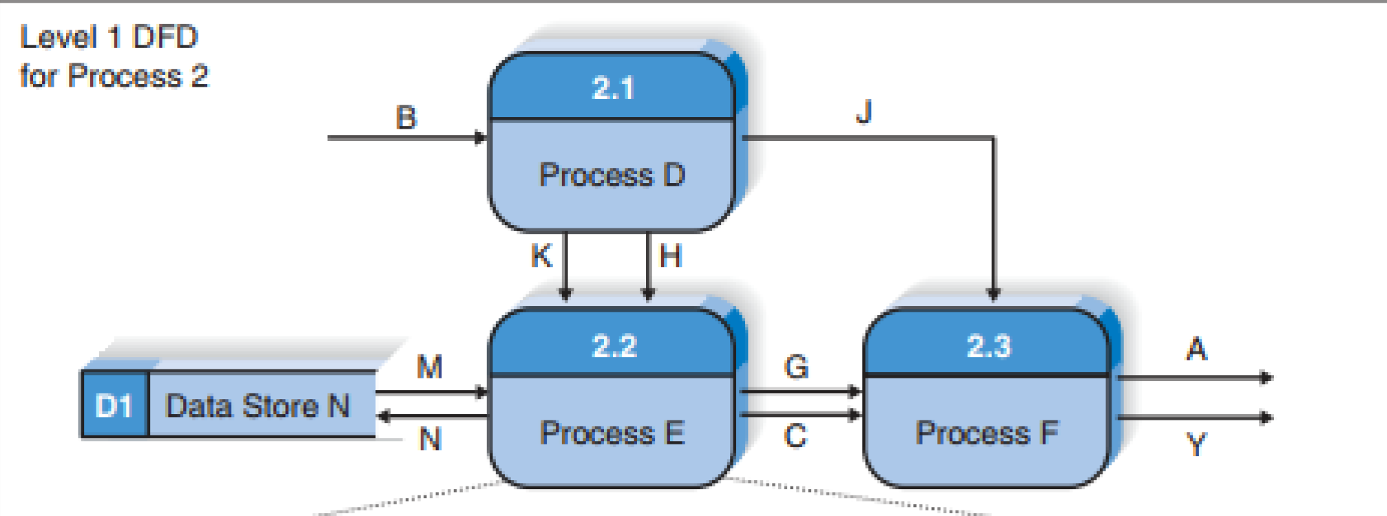
Level 1 Diagrams
The level 0 DFD shows only how the major high-level processes in the system interact.
Each process on the level 0 DFD can be decomposed into a more explicit DFD, called a level 1 diagram, or level 1 DFD
level 1 DFD shows how it operates in greater detail.

Slide 20
Level 1 Diagrams
In general, all process models have as many level 1 diagrams as there are processes on the level 0 diagram
every process in the level 0 DFD would be decomposed into its own level 1 DFD

Slide 21
Creating Data Flow Diagrams
Data flow diagrams start with the information in the use cases and the requirements definition
the DFDs typically are created by the project team and then reviewed by the users
The project team takes the use cases and rewrites them as DFDs
DFDs have formal rules about symbols and syntax that use cases do not, the project team sometimes has to revise some of the information in the use cases to make them conform to the DFD rules

Slide 22
Creating Data Flow Diagrams
The most common types of changes are
names of the use cases that become processes and the inputs and outputs that become data flows.
combine several small inputs and outputs in the use cases into larger data flows in the DFDs (e.g., combining three separate inputs, such as “customer name,” “customer address,” and “customer phone number,” into one data flow, such as “customer information”).

Slide 23
Creating Data Flow Diagrams STEPS
1- to begin process modeling by focusing first on the level 0 diagram
showing all the external entities and the data flows that originate from or terminate in them
2- the team creates a DFD fragment for each use case that shows how the use case exchanges data flows with the external entities and data stores.
3- these DFD fragments are organized into a level 0 DFD.
4- the team develops level 1 DFDs, based on the steps within each use case, to better explain how they operate. Then DFD 2, DFD3, …
5- the team validates the set of DFDs to make sure that they are complete and correct

